Slide 1
Business Analytics Logistic Regression

Slide 2
Why do we ever need Logistic Regression?
Violates the assumption of Linear Regression!
Assumption says that the residulas should be normally distributed.
The error term can only take on two values, hence it's impossible for it to have a normal distribution.
Violates the assumption of Homoscedasticity!
Homoscedasticity describes a situation in which the error term is the same across all values of the independent variables.

Slide 3
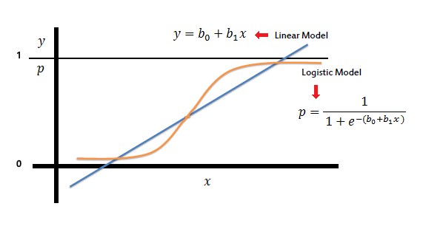

Logistic Regression

Slide 4
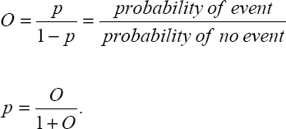
Odds and Odds Ratio

Slide 5
Odds and Odds Ratio
Suppose that seven out of 10 males are admitted to an Business school while three of 10 females are admitted.
The probabilities for admitting a male are, p = 7/10 = .7 q = 1 - .7 = .3
If you are male, the probability of being admitted is 0.7 and the probability of not being admitted is 0.3.
Here are the same probabilities for females, p = 3/10 = .3 q = 1 - .3 = .7
If you are female it is just the opposite, the probability of being admitted is 0.3 and the probability of not being admitted is 0.7.
Now we can use the probabilities to compute the odds of admission for both males and females, odds(male) = .7/.3 = 2.33333 odds(female) = .3/.7 = .42857
Next, we compute the odds ratio for admission, OR = 2.3333/.42857 = 5.44
Thus, for a male, the odds of being admitted are 5.44 times larger than the odds for a female being admitted.

Slide 6
Why do need Odds and Odds Ratio?
Probability | Odds
.1 | .11
.2 | .25
.3 | .43
.4 | .67
.5 | 1.00
.6 | 1.50
.7 | 2.33
.8 | 4.00
.9 | 9.00
Odds | Probability
3 | 0.75
8 | 0.888
18 | 0.947

Slide 7
Baseline, R Square and Max-rescaled R square and C
What is R square?
R square of Logistic Regression?
Hosmer and Lemeshow’s R square = -2LL(model) / -2LL(Original)
How much the badness of fit improves!!
Cox and Snell’s R square used by SAS – a different approach!
Cox and Snell’s R square never reaches the theoretical value of 1
Hence Max-rescaled R-Square was suggested by Nagelkerke
C statistics – based on receiver operating characteristic (ROC) curve

Slide 8
What are Dummy Variable, Design Variable, Boolean Indicators and Proxies?
These are all the synonyms for dummy variable
Categorical Variables – Male / Female, High Low Bank Bal etc
They are coded with 1 and 0
Class | Class_Dummy1 | Class_Dummy2
1 | 1 | 0
1 | 1 | 0
1 | 1 | 0
2 | 0 | 1
2 | 0 | 1
2 | 0 | 1
3 | 0 | 0
3 | 0 | 0
3 | 0 | 0

Slide 9
Results and Interpretation
R-Square 0.0841 Max-rescaled R-Square 0.1130
Testing Global Null Hypothesis: BETA=0
Test | Chi-Square | DF | Pr > ChiSq
Likelihood Ratio | 12.206 | 3 | 0.0067
Score | 11.656 | 3 | 0.0087
Wald | 10.8211 | 3 | 0.0127
Several methods to test the null hypothesis that beta=0

Slide 10
Results and Interpretation
Analysis of Maximum Likelihood Estimates
Parameter | DF | Estimate | Standard Error | Wald Chi-Square | Pr > ChiSq
Intercept | 1 | "-2.6516" | 0.6748 | 15.4424 | <.0001
blackd | 1 | 0.5952 | 0.3939 | 2.2827 | 0.1308
whitvic | 1 | 0.2565 | 0.4002 | 0.4107 | 0.5216
serious | 1 | 0.1871 | 0.0612 | 9.3342 | 0.0022
Odds Ratio Estimates
Effect | Point Estimate | 95% Wald Confidence Limits
blackd | 1.813 | 0.838 | 3.925
whitvic | 1.292 | 0.59 | 2.832
serious | 1.206 | 1.069 | 1.359

Slide 11
Results and Interpretation
Association of Predicted Probabilities and Observed Responses
Percent Concordant | 67.2 | Somers' D (Gini Index) | 0.349
Percent Discordant | 32.3 | Gamma | 0.351
Percent Tied | 0.5 | Tau-a | 0.158
Pairs | 4850 | c | 0.675
All the statistics ranges from 0 to 1 (except C statistics); 1 being the closest association.
C statistics ranges from 0.5 to 1; 1 being the best prediction

Slide 12
Check Multicollinearity!!
Check the VIF / Tolerance to detect the multicollinearity!!

Slide 13
Two classes of fit statistics
Measures of predictive power—How well can we explain/predict the dependent variable based on the independent variables
R-square measures
Area under the ROC curve – C Statistics
Goodness-of fit (GOF) tests
Deviance
Pearson chi-square
Hosmer-Lemeshow
Cross Validation / Bootstrapping
Predictive power and GOF are very different things:
A model can have very high R-square, yet GOF is terrible.
Similarly, GOF might be great but R-square is low.

Slide 14
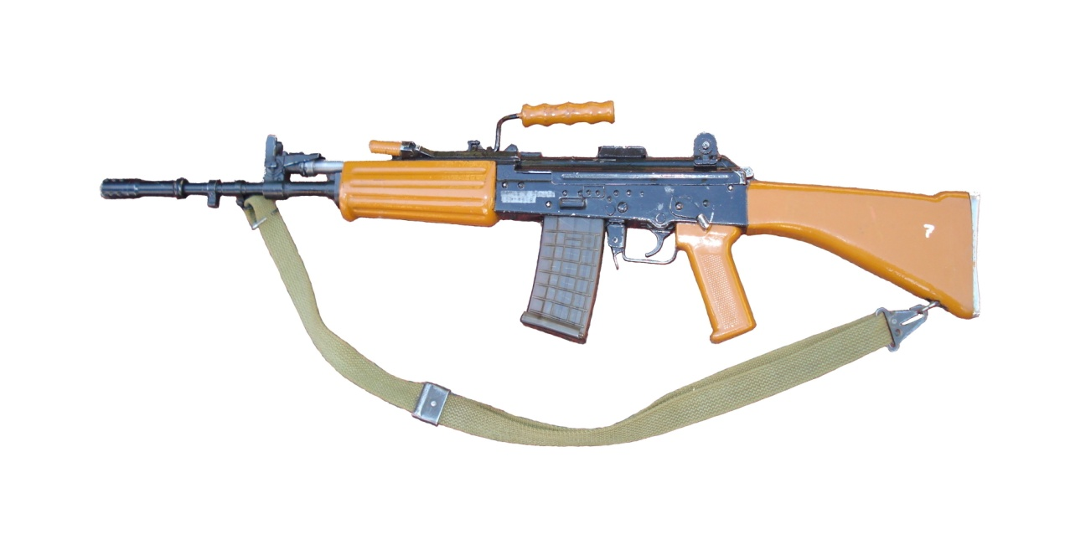
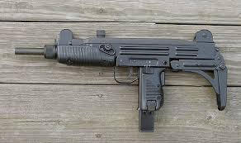


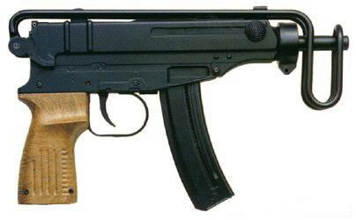
Two classes of fit statistics

Slide 15
Results and Interpretation – Hosmer and Lemeshow Test
Partition for the Hosmer and Lemeshow Test
hiwrite = 1 hiwrite = 0
Group Total Observed Expected Observed Expected
1 20 0 1.08 20 18.92
2 20 4 3.45 16 16.55
3 20 9 6.54 11 13.46
4 21 10 10.86 11 10.14
5 20 13 13.64 7 6.36
6 20 17 15.70 3 4.30
7 20 16 17.44 4 2.56
8 20 18 18.76 2 1.24
9 20 20 19.61 0 0.39
10 19 19 18.90 0 0.10
Hosmer and Lemeshow Goodness-of-Fit Test
Chi-Square DF Pr > ChiSq
5.2766 8 0.7276
Null hypothesis that there is no difference between the observed and predicted values.
High p-values indicate that the model fits well.

Slide 16
Results and Interpretation – Classification Table
Correct |  |  | Incorrect |  | Percentages
Prob |  | Non- |  | Non- |  | Sensi- | Speci- | FALSE | FALSE
Level | Event | Event | Event | Event | Correct | tivity | ficity | POS | NEG
0.05 | 30 | 47 | 23 | 0 | 77 | 100 | 67.1 | 43.4 | 0
0.1 | 30 | 53 | 17 | 0 | 83 | 100 | 75.7 | 36.2 | 0
0.15 | 30 | 55 | 15 | 0 | 85 | 100 | 78.6 | 33.3 | 0
0.2 | 30 | 60 | 10 | 0 | 90 | 100 | 85.7 | 25 | 0
0.25 | 29 | 61 | 9 | 1 | 90 | 96.7 | 87.1 | 23.7 | 1.6
0.3 | 25 | 62 | 8 | 5 | 87 | 83.3 | 88.6 | 24.2 | 7.5
0.35 | 23 | 62 | 8 | 7 | 85 | 76.7 | 88.6 | 25.8 | 10.1
0.4 | 23 | 63 | 7 | 7 | 86 | 76.7 | 90 | 23.3 | 10
0.45 | 23 | 63 | 7 | 7 | 86 | 76.7 | 90 | 23.3 | 10
0.5 | 23 | 63 | 7 | 7 | 86 | 76.7 | 90 | 23.3 | 10
Higher sensitivity and specificity indicates better fit.
Default cutoff prob = 0.5

Slide 17



Justice League Vs Super Villains

Slide 18
Results and Interpretation – Predicted Probability
Obs | CURED | INTERVENTION | DURATION | _LEVEL_ | pred
1 | 0 | 0 | 7 | 1 | 0.42812
2 | 0 | 0 | 7 | 1 | 0.42812
3 | 0 | 0 | 6 | 1 | 0.43004
4 | 1 | 0 | 8 | 1 | 0.42621
5 | 1 | 1 | 7 | 1 | 0.71991
6 | 1 | 0 | 6 | 1 | 0.43004
Predicted Probability snap shot

Slide 19
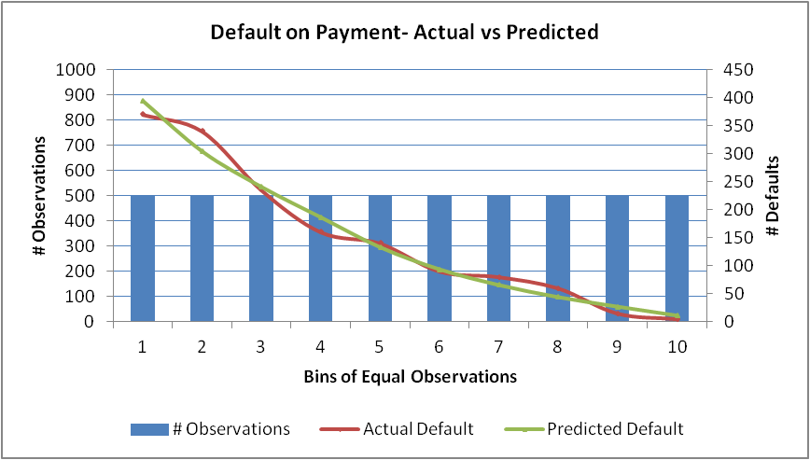
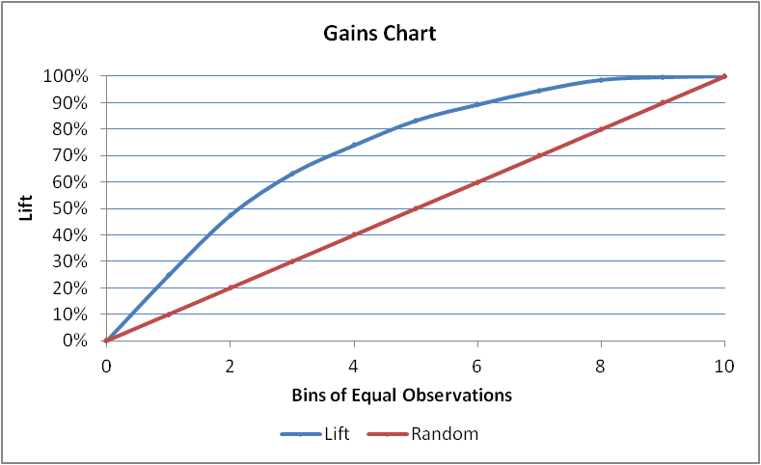
Logistic Regression – Gains curve and Gini
Bins | # Observations | Actual Default | Predicted Default | Cumulative Actual | Lift | Random | Area | Gini
0 | 0 | 0 | 0 | 0 | 0 | 0 | 0.00000 | 44.98%
1 | 500 | 370 | 394 | 370 | 24.75% | 10.00% | 0.01237
2 | 500 | 340 | 304 | 710 | 47.49% | 20.00% | 0.03612
3 | 500 | 235 | 240 | 945 | 63.21% | 30.00% | 0.05535
4 | 500 | 160 | 186 | 1105 | 73.91% | 40.00% | 0.06856
5 | 500 | 140 | 132 | 1245 | 83.28% | 50.00% | 0.07860
6 | 500 | 90 | 93 | 1335 | 89.30% | 60.00% | 0.08629
7 | 500 | 80 | 65 | 1415 | 94.65% | 70.00% | 0.09197
8 | 500 | 60 | 44 | 1475 | 98.66% | 80.00% | 0.09666
9 | 500 | 15 | 27 | 1490 | 99.67% | 90.00% | 0.09916
10 | 500 | 5 | 11 | 1495 | 100.00% | 100.00% | 0.09983

Slide 20
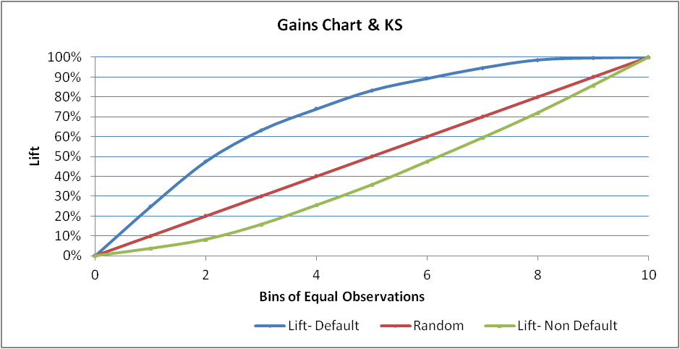
Logistic Regression – KS Stat
Bins | # Observations | Actual Default | Actual Non Default | Predicted Default | Cumulative Default | Cumulative Non Default | Lift- Default | Lift- Non Default | Random | Area | Gini
0 | 0 | 0 | 0 | 0 | 0 | 0 | 0 | 0 | 0 | 0.00000 | 44.98%
1 | 500 | 370 | 130 | 394 | 370 | 130 | 24.75% | 3.71% | 10.00% | 0.01237
2 | 500 | 340 | 160 | 304 | 710 | 290 | 47.49% | 8.27% | 20.00% | 0.03612
3 | 500 | 235 | 265 | 240 | 945 | 555 | 63.21% | 15.83% | 30.00% | 0.05535
4 | 500 | 160 | 340 | 186 | 1105 | 895 | 73.91% | 25.53% | 40.00% | 0.06856
5 | 500 | 140 | 360 | 132 | 1245 | 1255 | 83.28% | 35.81% | 50.00% | 0.07860
6 | 500 | 90 | 410 | 93 | 1335 | 1665 | 89.30% | 47.50% | 60.00% | 0.08629
7 | 500 | 80 | 420 | 65 | 1415 | 2085 | 94.65% | 59.49% | 70.00% | 0.09197
8 | 500 | 60 | 440 | 44 | 1475 | 2525 | 98.66% | 72.04% | 80.00% | 0.09666
9 | 500 | 15 | 485 | 27 | 1490 | 3010 | 99.67% | 85.88% | 90.00% | 0.09916
10 | 500 | 5 | 495 | 11 | 1495 | 3505 | 100.00% | 100.00% | 100.00% | 0.09983
Difference: Cumulative Default & Non Defaullt
0
21.04%
39.22%
47.38%
48.38%
47.47%
41.79%
35.16%
26.62%
13.79%
0.00%
The difference between %Cumulative Default (Bad) and Non Default (Good) is 48.38% which is occurring at 4th decile
At 4th decile, model is able to capture 73.91% of total bads
i.e. if we follow the model, in 40% of records we can capture 78.91% of total bads
The K-S of the model is 48.38% at 4th decile

Slide 21
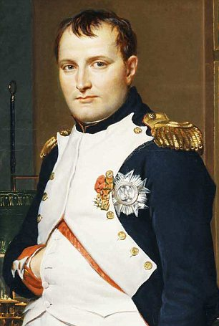

Population Stability Index (PSI)
Source: http://ucanalytics.com/

Slide 22
Population Stability Index (PSI)
Score bands | Actual % | Expected % | Ac-Ex | ln(Ac/Ex) | Index
< 251 | 5% | 8% | -3% | -0.47 | 0.014
251–290 | 6% | 9% | -3% | -0.41 | 0.012
291–320 | 6% | 10% | -4% | -0.51 | 0.020
321–350 | 8% | 13% | -5% | -0.49 | 0.024
351–380 | 10% | 12% | -2% | -0.18 | 0.004
381–410 | 12% | 11% | 1% | 0.09 | 0.001
411–440 | 14% | 10% | 4% | 0.34 | 0.013
441–470 | 14% | 9% | 5% | 0.44 | 0.022
471–520 | 13% | 9% | 4% | 0.37 | 0.015
520 < | 9% | 8% | 1% | 0.12 | 0.001
Population Stability Index (PSI)= |  |  |  |  | 0.1269

Slide 23
Population Stability Index (PSI)
PSI Value | Inference | Action
Less than 0.1 | Insignificant change | No action required
0.1 – 0.25 | Some minor change | Check other scorecard monitoring metrics
Greater than 0.25 | Major shift in population | Need to delve deeper

Slide 24




Visit Ivy’s Blog for Career Tips, Latest Info, Job Alerts - www.ivyproschool.com/blog
Interact with us at -
Ivy Professional School
14 B | Camac Street | Kolkata – 17 www.ivyproschool.com | info@ivyproschool.com T: 033 400 11221 | SMS: 9748 441111

